Slide 1
EDA Presentation

Slide 2
MEMBER DETAILS
Member 1:
Name – Gabriel Aluede
Email – ghabyaluede@gmail.com
Country – United Kingdom
College – Teesside University
Specialization – NLP
Member 2:
Name – Yosha Udaya Shriyan
Email – yosha.shriyan@gmail.com
Country – United Kingdom
College – Royal Holloway University of London
Specialization – NLP

Slide 3
PROBLEM DESCRIPTION
The term hate speech is understood as any type of verbal, written or behavioural communication that attacks or uses derogatory or discriminatory language against a person or group based on what they are, in other words, based on their religion, ethnicity, nationality, race, colour, ancestry, sex or another identity factor. In this problem, we will take you through a hate speech detection model with Machine Learning and Python.

Slide 4
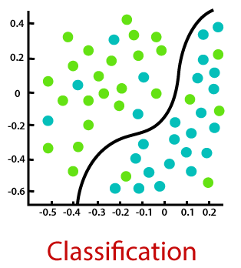
NLP as Classification
NLP system needs to understand text, sign, and semantic properly.
The most common form of unstructured data is texts and speeches.
It’s plenty but hard to extract useful information.
NLP can analyze these data for us and do the task like sentiment analysis, cognitive assistant, spam filtering, identifying fake news, and real-time language translation.

Slide 5
Model Selection – Text Classification
As our problem statement requires us to distinguish between a tweet that is hateful in nature to one that isn’t, we use a model that accomplishes this task.
As we have to categorise, we use a text classification model for the problem.
Text classification is a machine learning technique that assigns a set of predefined categories to open-ended text.

